Slide 1
INTRODUCTION TO
Spring Boot & Cloud Foundry
Notes:
last update: 4/3/2013

Slide 2
Spring Boot
Stand-alone, production-grade applications
Ready to run.
“Opinionated” view of the Spring platform & 3rd party libraries Minimizes manual Spring configuration.
Don’t need to concerned with every aspect of its lifecycle including deployment and management.
Spring Boot Definition

Slide 3
Spring Boot
“Menu-based” creation of stand-alone, production-grade Apps
Spring Boot applications need a reduced amount of Spring configuration.
Pre-configured POM files to assist your initial project configuration.
Eliminates some configuration work and has no requirements for XML
Support for security, metrics, and health checks - production-ready apps
Dev-Ops friendly - developers focus on business features not on infrastructure.
Designed to make microservices a resource-conscious, developer-focused process.
Assists in decomposing monolithic services into distributed microservices
Spring Boot Reference
Spring Boot Application Properties
Spring Boot Definition
Spring Boot Developer Tools

Slide 4
Spring Boot &
Microservice Architecture
A Microservice Architecture typically does NOT have a built in UI component [Presentation Tier].
It is a distributed “business” service architecture [ RE: RESTful Web Services].
By default, Spring (Boot) applications have only one ApplicationContext.
There's no distinction between a root web application context and a servlet web application context in Spring Boot.
So,
by default, a Spring Boot application with “built in” Server Side Rendering [HTML page delivery] is a Monolith…

Slide 5
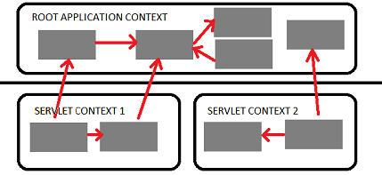

Web Application Context
Spring has multilevel application context hierarchies.
Web apps by default have two hierarchy levels, root and servlet contexts:
Spring Boot requires custom Configuration to separate the Servlet Web Application Context from the Root WebApplication Context.
Root WebApplicationContext
Security
WebApplicationContext
Presentation tier

Slide 6
Application Start
The @SpringBootApplication annotation is equivalent to using @Configuration, @EnableAutoConfiguration and @ComponentScan with their default attributes
It is on “main” method in ROOT package…
@SpringBootApplication
public class HelloSpringThymeBootApplication {
public static void main(String[] args) {
SpringApplication.run(HelloSpringThymeBootApplication.class, args);
}
}
@SpringBootApplication allows for customization of the attributes of @EnableAutoConfiguration and @ComponentScan.
Customization Example:
@SpringBootApplication(scanBasePackages = “edu.mum")
Notes:
@SpringBootApplication(scanBasePackages = “edu.mum")
@SpringBootApplication , by default scans “current” package & sub packages
https://dzone.com/articles/how-spring-boot-initialize-the-spring-mvc-applicat
@EnableAutoConfiguration -- opinionated configuration

Slide 7
@AutoConfiguration
Guess and configure beans that you are likely to need.
Auto-configuration classes are usually applied based on your classpath and what beans you have defined.
Auto-configuration tries to be as intelligent as possible and will back-away as you define more of your own configuration.
Customization of Boot configured beans is through:
Spring Application Properties

Slide 8
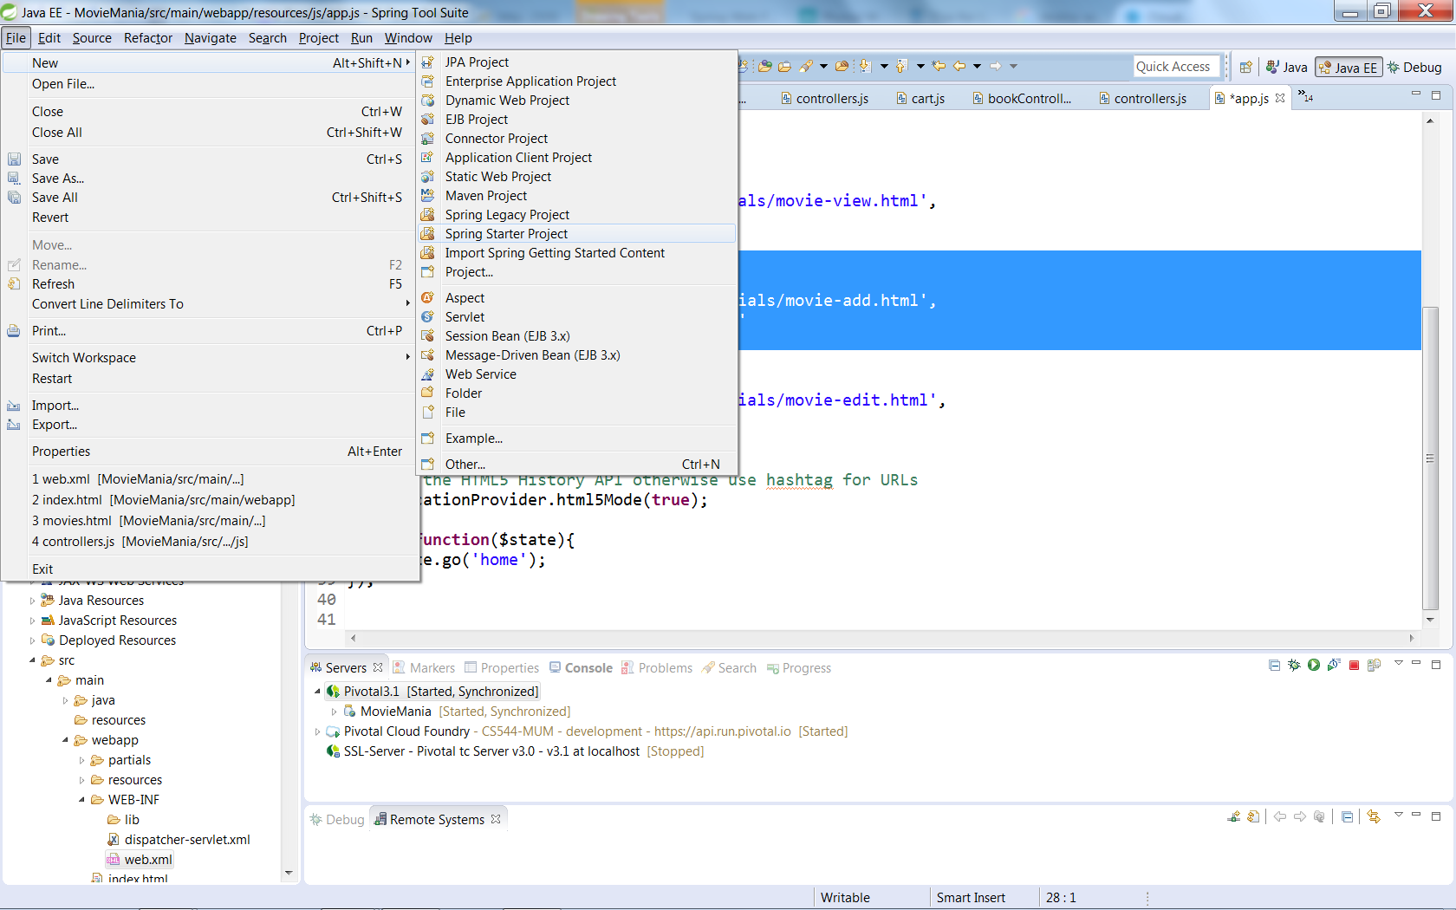
Start a Project with Spring Boot

Slide 9
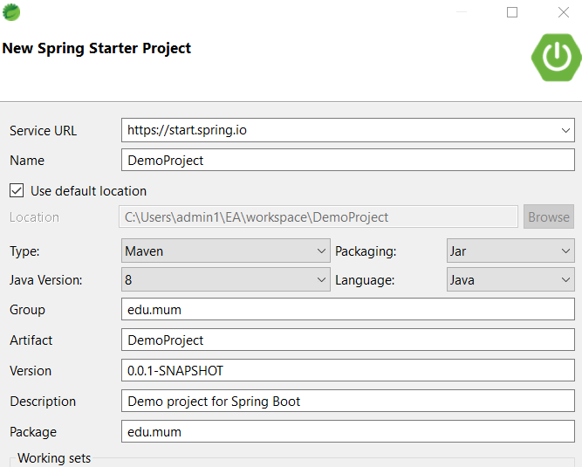
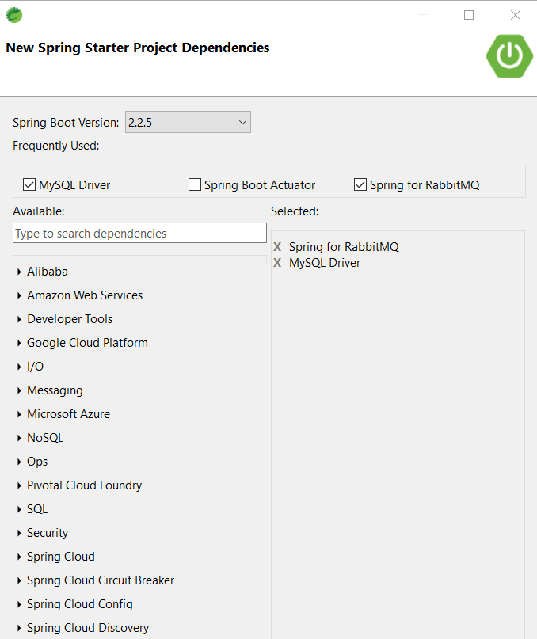
New Spring Boot
Project
Menu Selection
Notes:
Spring Boot Actuator includes a number of additional features to help you monitor and manage your application when it's pushed to production.
using boot DEV TOOLS – auto restart, remote debug…

Slide 10
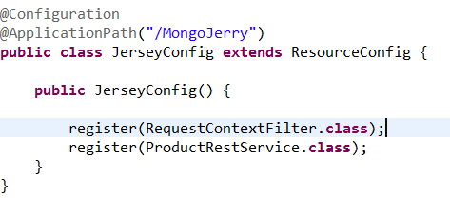

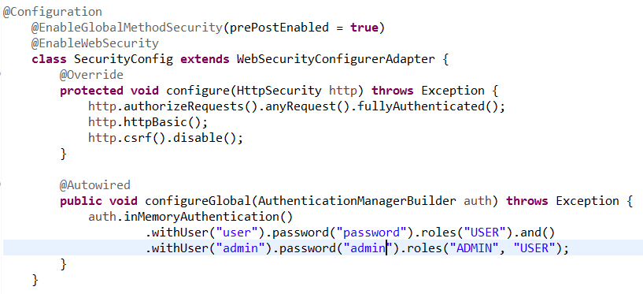
Spring Boot
Custom Configuration
Register Jersey Rest Services
Set Application Path
Application Properties
Security Authentication
Default users & Authorization
See Demo for More Details
Notes:
Spring Boot Developer Tools
If you define a @Configuration with @EnableWebSecurity anywhere in your application it will switch off the default webapp security settings in Spring Boot

Slide 11
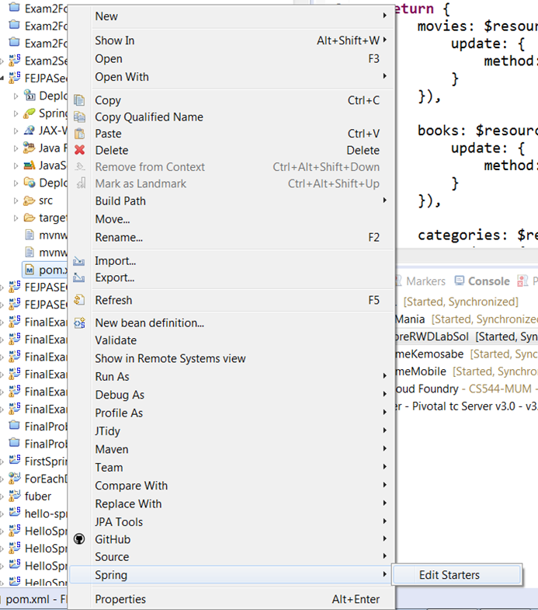
Edit an Existing Boot Project
The Edit Starters wizard is accessible by right-clicking a Maven project's pom.xml, from menu Spring >> Edit Starters.

Slide 12
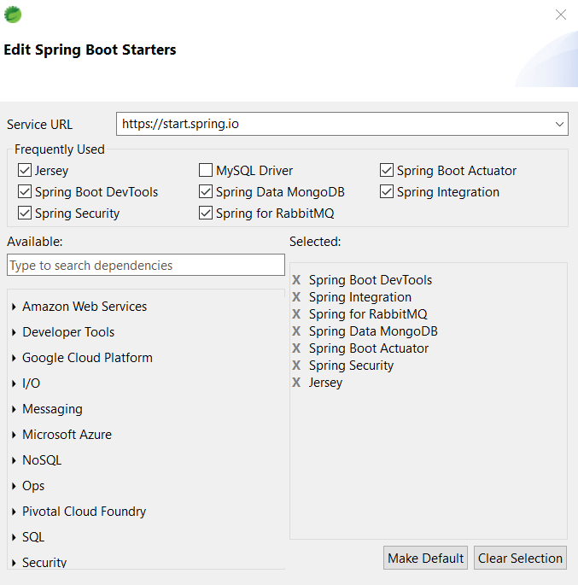
Edit Starters Screen

Slide 13
The Cloud
Very broad concept
covers just about every possible sort of online service
USUALLY refers to
Software as a Service (SaaS)
3rd party software [ SalesForce, DropBox, etc.]
Platform as a Service (PaaS)
Platform on which software is developed/deployed.
Infrastructure as a Service (IaaS).
Automated and scalable computing resources,
cloud storage and networks. Client control over
infrastructure

Slide 14
Cloud Migration Strategies
Lift-and-shift [ Rehosting]
Reduction of cost and improved performance and resiliency.
applications are easier to optimize/re-architect once they’re already
running in the cloud.
Replatforming [ “lift-tinker-and-shift.”]
Database-as-a-service
Embedded Tomcat
Refactoring / Re-architecting
AKA use cloud-native features AKA use microservices
driven by a strong business need – use case
most expensive, but, if you have a good product-market fit

Slide 15
12 Factor [Cloud] Apps
“how to build a successful app” by Heruku 12 factor apps
…adopted by … major software platforms and frameworks***
Codebase
One codebase tracked in revision control, many deploys
[ Use SVN;github] ****
Dependencies
Explicitly declare and isolate dependencies [Maven;gradle] *****
Config
Store config in the environment
[anything that varies between environments.]
Backing Services
Treat backing services as attached resources
[CLOUD – Attach services]**** 12 Factors
Notes:
http://www.clearlytech.com/2014/01/04/12-factor-apps-plain-english/
Backing Services
Could be running on the same machine, or they might be on a different host, in a different datacenter, or managed by a cloud SaaS company. The point is, your code shouldn’t know the difference.

Slide 16
Build, release, run
Strictly separate build and run stages
Processes
Execute the app as one or more stateless processes
Port binding
Export services via port binding
Concurrency
Scale out via the process model
Disposability
Maximize robustness - fast startup and graceful shutdown
Development – Production Parity
Keep development, staging, and production similar
Logs
Treat logs as event streams
Admin processes
Run admin/management tasks as one-off processes
Notes:
Concurrency … keep your microservices as independent processes
PORT BINDING
does not rely on runtime injection of a webserver into the execution environment to create a web-facing service This is typically implemented by using dependency declaration to add a webserver library to the app

Slide 17
Cloud Foundry
A multi-cloud Approach
Cloud Foundry is an application PaaS, and let's you concentrate on your application and its associated services instead of the infrastructure itself.
Single platform for application development.
Removes grunt work of running the infrastructure
No infrastructure platform lock in.
Easily move applications from one cloud to another (or use multiple clouds simultaneously)
Open Source Foundation [70+ members] includes Microsoft, Google, IBM
Can be built on a range of cloud providers. [AWS, Microsoft Azure, Google Cloud Platform]

Slide 18
Cloud Foundry, Pivotal Cloud Foundry Pivotal Web Services
DEFINITIONS:
Cloud Foundry open source software is the community maintained , community supported software and tools required to run Cloud Foundry on your own infrastructure.
https://cloudfoundry.org
Pivotal Cloud Foundry is a Pivotal branded installation of Cloud Foundry on your own infrastructure (AWS, VMware, OpenStack, Azure, etc) which has enterprise grade support. It also offers an array of services like MySQL,, RabbitMQ, etc. that can leverage their cloudfoundry installation and have applications that use these services.
Pivotal Cloud Foundry
Pivotal Web Services is a Pivotal's hosted Cloudfoundry for people and companies who want to develop cloudfoundry applications but don't want to operate and manage their own infrastructure and Cloud Foundry installation. Deployed on AWS
https://run.pivotal.io
Notes:
Pivotal Cloud Foundry offers a public cloud offering called Pivotal Web Services where you can signup and deploy your apps on the cloud which is hosted by Pivotal.
Pivotal Web Services is a hosted environment, running on AWS
A commercial version called Pivotal Cloud Foundry (PCF) is available from Pivotal. It provides extra tools for installation and administration not included in the open software product. Pivotal Web Services (PWS), however, is an instance of Pivotal Cloud Foundry hosted on Amazon Web Services (AWS).

Slide 19
Spring Cloud Support
Spring Cloud Config
Centralized external configuration management backed by a git repository. The configuration resources map directly to Spring `Environment` but could be used by non-Spring applications if desired.
Spring Cloud Netflix
Integration with various Netflix OSS components (Eureka, Hystrix, Zuul, Archaius, etc.)
Spring Cloud Bus
An event bus for linking services and service instances together with distributed messaging. Useful for propagating state changes across a cluster (e.g. config change event )
Spring Cloud for Cloud Foundry
Integrates your application with Pivotal Cloudfoundry. Provides a service discovery implementation and also makes it easy to implement SSO and OAuth2 protected resources, and also to create a Cloud Foundry service broker.
Spring Cloud Cluster
Leadership election and common stateful patterns with an abstraction and implementation for Zookeeper, Redis, Hazelcast, Consul.
Spring Cloud Consul
Service discovery and configuration management with Hashicorp Consul.
ETC…, ETC..., ETC…

Slide 20
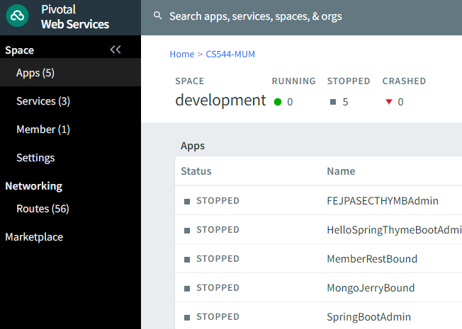
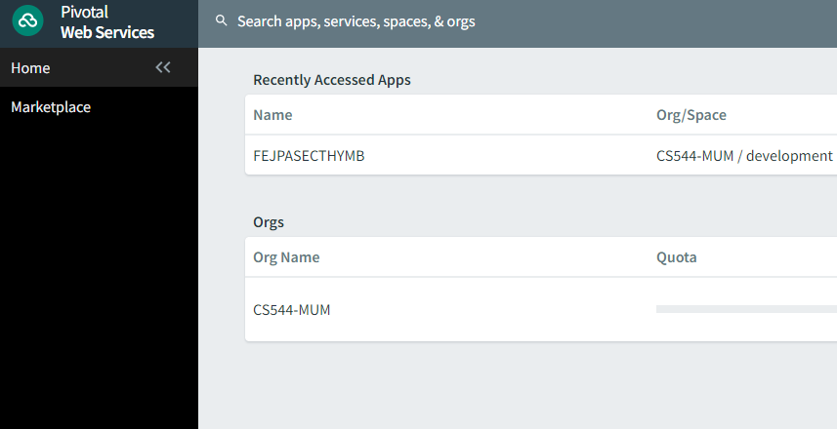
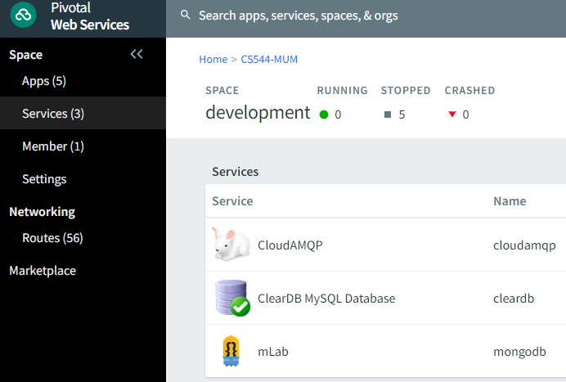
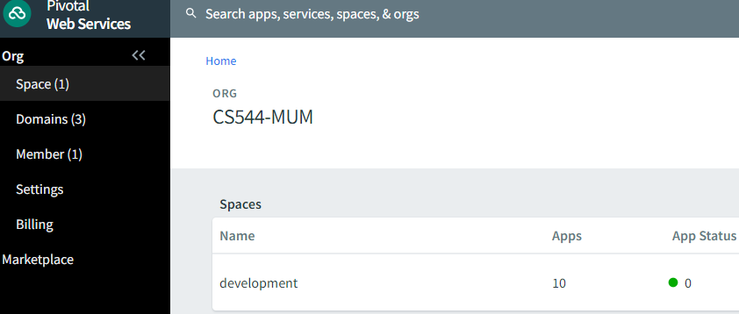
Pivotal Cloud Foundry
Pivotal Web Servic es Home
LOGIN…
Click On Org
Click on Space

Slide 21
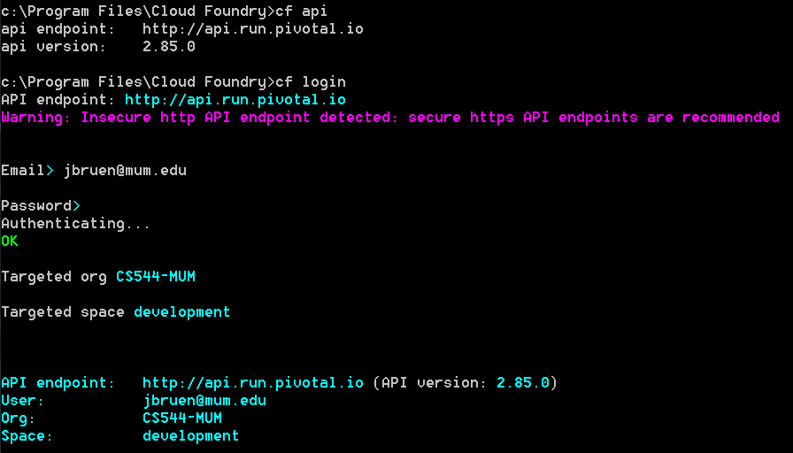

Cloud Foundry CLI Login
Cloud Foundry Command Line Interface
Get endpoint…[version #]
Notes:
cf api
cf login –a https://api.run.pivotal.io –u jbruen@mum.edu
Cf apps
Cf services
Cf logs HelloSpringThymeBoot –recent

Slide 22
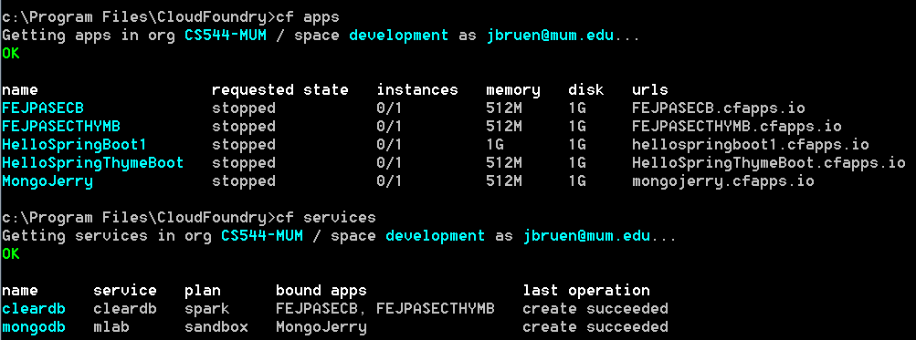
View Apps & Services
Notes:
How to enable SSH to look at files
https://discuss.pivotal.io/hc/en-us/articles/228014907-Troubleshooting-Guide-on-Configuring-and-Using-CF-SSH

Slide 23
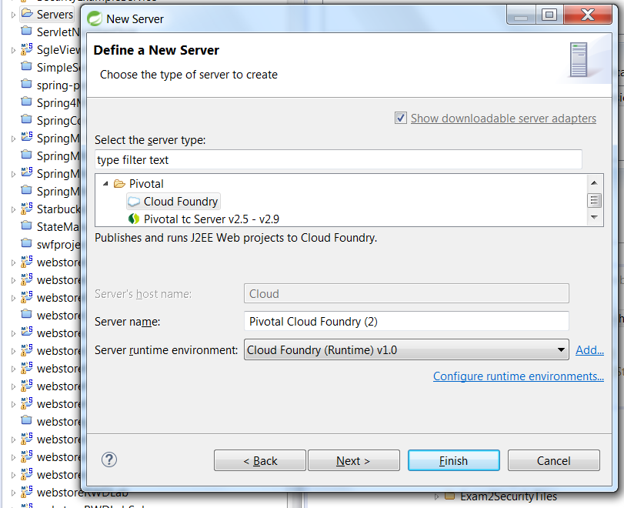
Using Eclipse Plugin
Cloud Foundry Eclipse Plugin
Start new server right click servers [project explorer]
new >> other >> servers >> server …Pivotal >> Cloud Foundry

Slide 24
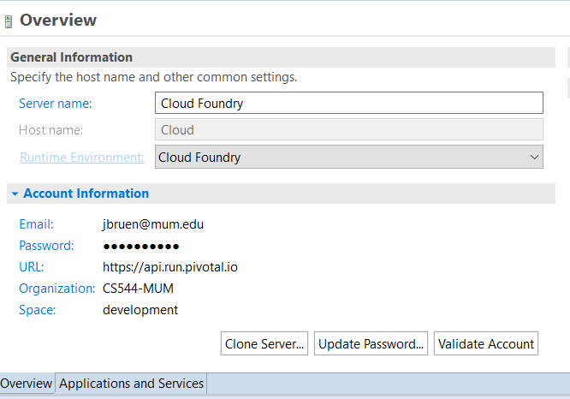
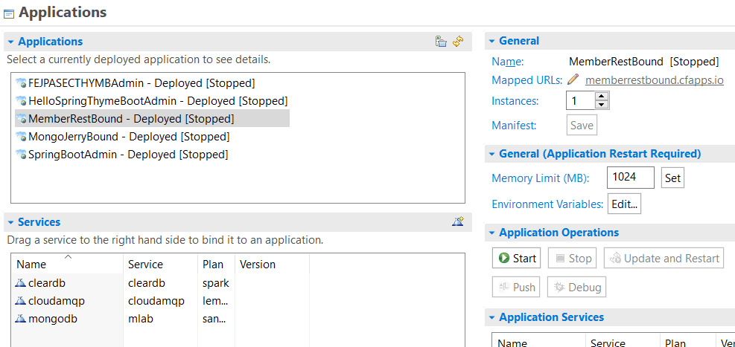

Slide 25
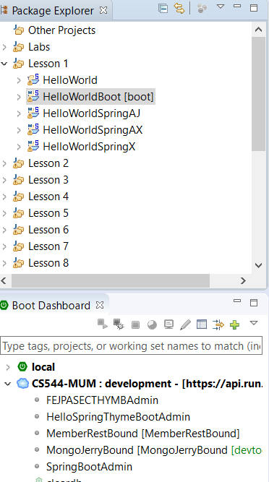
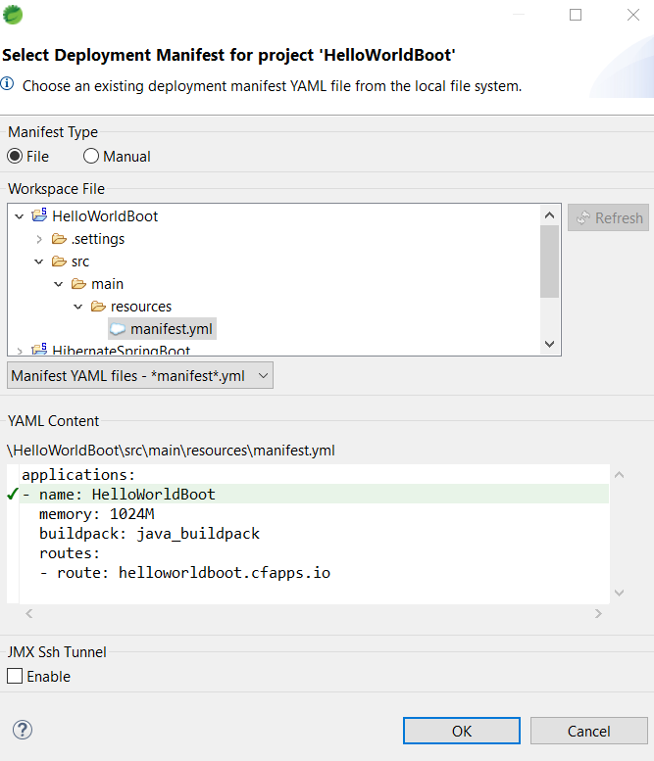
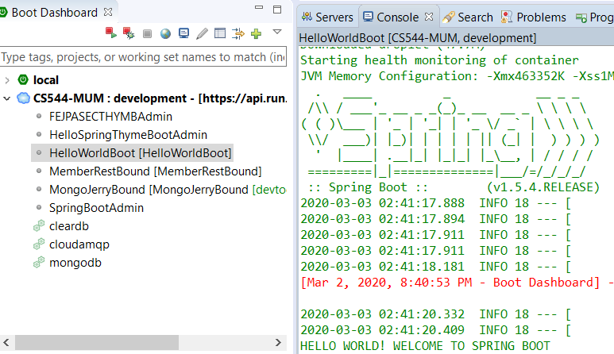
Drag & Drop Boot Dashboard

Slide 26
Cloud Deployment Types
[W/R to Application Servers]
No External Server
Package the application, with all its dependencies,
into a single “fat” JAR file - can include an
embedded framework with optional third-party libraries
that will be compatible.
{Spring Boot w/Embedded Tomcat}
Cloud provided Server
Package a container [e.g Java EE,Tomcat ] and its service
implementation in a Container [Linux - Docker,Heruku].
Layered, cached dependencies; Linux type/version agnostic {Spring Boot w/WAR file}
Notes:
http://www.altoros.com/blog/how-to-deploy-spring-boot-applications-in-docker-containers/
ttps://dzone.com/articles/building-microservices-with-java
https://conferences.oreilly.com/software-architecture/sa-eu-2016/public/schedule/detail/52602
Container-less pick and choose Applcation container features…
WE are TALKING ABOUT Application CONTAINER [JEE, etc] vs linux container[LXC ] basically a VM
https://www.infoworld.com/article/3204171/linux/what-is-docker-linux-containers-explained.html
Docker – IS a LXC with enhancements- more portable; decouple from LXC
CONTAINER-LESS – Application container
http://www.grahambrooks.com/2014/04/07/container-less-web-applications.html
Servers took a long time to commission and configure. Containers were a way of deploying applications more quickly and with greater safety. But time change and today’s patterns and teams favour lighter weight, nimble solutions. Our ability to manage servers and networks through code is one of the key drivers for this change.
https://www.cloudfoundry.org/blog/lets-talk-serverless/

Slide 27
CLOUD AMQP Setup
Add cloudampq in STS
Use plan Lemur [free]
From pivotal services login YOU can access Rabbit admin:
From “HOME”
Click on org name [cs544-MUM]
Click on development [space]
Click on MongoJerryBound
Click on Services
Click on cloudamqp
Click on manage
Click on RabbitMQ Manage…[upper left]
THERE YOU ARE!!!

